Slide 1
Ch 5 Rational Functions Lesson 5.1 Simplifying Rational Expressions and NPV’s
© Copyright all rights reserved to Homework depot: www.BCMath.ca

Slide 2
i) Non-Permissible Values (NPV)
Permissible → Allowed, Non Permissible → Not Allowed
An NPV is a value of “x” (variable) that makes an equation undefined!
This occurs when an equation is dividing by Zero
When looking for NPV’s, check all the denominators in your expression, any value that makes your denominator equal to Zero is an NPV
Can’t divide by zero → Undefined!!
When finding the Non-Permissible Values
Take any denominator
Make it equal to zero
Then solve for “x” (variable)
Always Factor your denominators
These are the values of the variable that make a denominator equal to zero. Thus it is an Non-Permissible Value
© Copyright all rights reserved to Homework depot: www.BCMath.ca

Slide 3
Ex: Find the NPV for each Expression
Denominator
Factor
Equal to zero
Solve for “x”
“x” can NOT be 1/3, otherwise the expression will be undefined
© Copyright all rights reserved to Homework depot: www.BCMath.ca

Slide 4
II) What are Rational Expressions?
A rational expression is a fraction where both the numerator and denominator are polynomials [M12H CH3]
“x” can’t be an exponent or inside a radical, exponents of ‘x’ must be a integer [not fractions]
Examples of Polynomials:
Examples of Rational Functions:
The coefficients can be fractions, inside a square root, or have powers that are fractions
The variables ‘x” can not be inside a root, be a power, or have fractional exponents
These are NOT rational expressions

Slide 5
Which of these Are Rational Expressions?
Ex: Indicate whether if the following expressions are rational expressions?
YES
NO, b/c x³ is square rooted
NO, b/c variable “x” in an exponent
NO, b/c x³ is square rooted
YES, b/c if simplified, it becomes 12x³
YES, b/c the x⁻² can become x² in the numerator
YES
YES
NO, can’t sq root x² and x⁶
YES

Slide 6
Practice: Find the NPV’s for each of the following expressions

Slide 8
Practice: Find the NPV’s for each of the following expressions

Slide 10
Reducing and Simplifying Rational Expressions?
When “simplifying” a rational expression, factor any trinomial, difference of squares, or any other polynomial first
Look for common factors that exist in both numerator and denominator to cancel out common terms
When looking for NPV’s, make sure to find them “BEFORE” you cancel any terms
IE: Simplify and find all NPV’s
Top/Bottom are both trinomials
Both top/bottom can be factored
Binomials can be simplified if you have one at the top and one at the bottom

Slide 11


Common BIG MISTAKES!!!
YOU can not cancel a common term from the top and bottom if it is added or subtracted!
NOOO!! nNoo….noo….
NOOO!! Same reason, can’t cancel the x’s like this
ALSO NO!!!!
You can’t cancel the “x’s” because they are added to another term on top and bottom
3 minutes of people saying “NO” in movies……

Slide 12
III) Simplifying R.E. with Binomials
To cancel out any binomial, it must be the same binomial in both your numerator and denominator….
Can’t cancel, b/c the binomials are not the same
If there is a binomial, you need to FACTOR out any common factors first before canceling out with any terms in your denominator
Factor
in the numerator
Factor: in the numerator

Slide 13
Simplify Each of the following and FIND all NPV’s:

Slide 14
When a variable has an exponent of 2, it means that there are two of them multiplied
The terms are separated by a minus sign.. So we need to factor out any GCF before we can cancel
After factoring, the binomials are the same top/bottom…cancel them…
Since all terms are multiplied on top and bottom, cancel out any common factors
Now, cancel out the other common factors….

Slide 15
Practice: Factor and Simplify
Factor the expression
Cancel out any common factors

Slide 16
IV) Multiplying/Dividing Rational Expressions
When multiplying or dividing Rational Expressions with polynomials, factor everything else and look for common binomials
Make sure to factor all differences of squares & trinomials
Cancel out any common binomial in both the numerator & denominator
Look for NPV’s from every bracket that appeared in denominator
Ex: Simplify & State the NPV
Factor each trinomial
Cancel out any common binomial
Look for NPV’s (Denominator)
© Copyright all rights reserved to Homework depot: www.BCMath.ca

Slide 17
Practice: Simplify & find all NPV’s
Look for NPV’s (Denominator)
Look for NPV’s (Denominator)
© Copyright all rights reserved to Homework depot: www.BCMath.ca

Slide 19
Extra Practice: Simplify each of the following and state the NPV’s

Slide 21
The non-permissible values are for x are

Slide 22
The non-permissible values are for x are

Slide 23
This expression inside can not be equal to zero. 2x^2 will always be bigger than zero. If you add 18 to 2x^2, it will always be greater than zero. Which means, it can not be equal to zero.
Therefore, this expression will not have any NPV’s

Slide 24
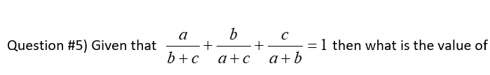

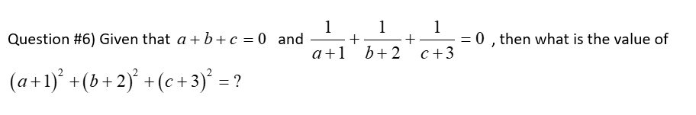
Q5) zero Q6) 36

Slide 25
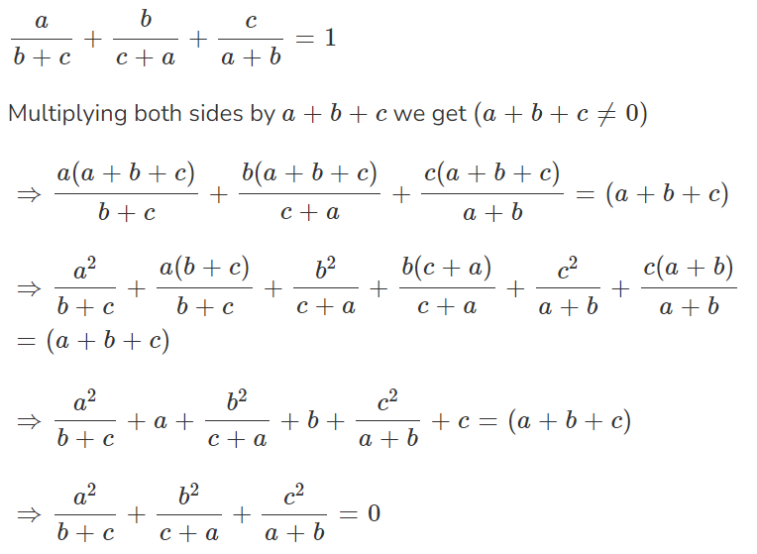

Slide 26
Equal to zero!

